Slide 1
Foundations of Management & Organizational Behaviour
Topic:Functional Management &Levels
Dr. C. Vijaya Banu
Professor , School of Management
SASTRA Deemed University, Thanjavur – 613 401
vijayabanu@mba.sastra.edu

Slide 2
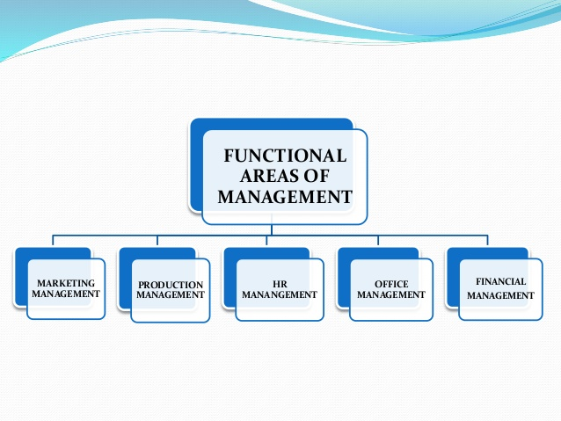

Slide 3
Functional Areas of Management

Slide 4
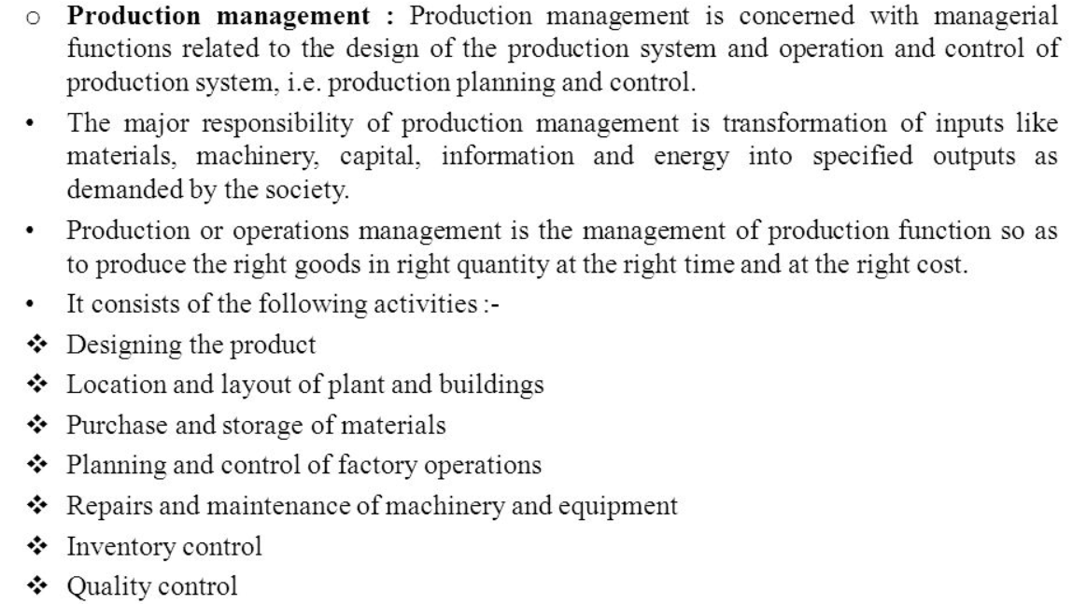
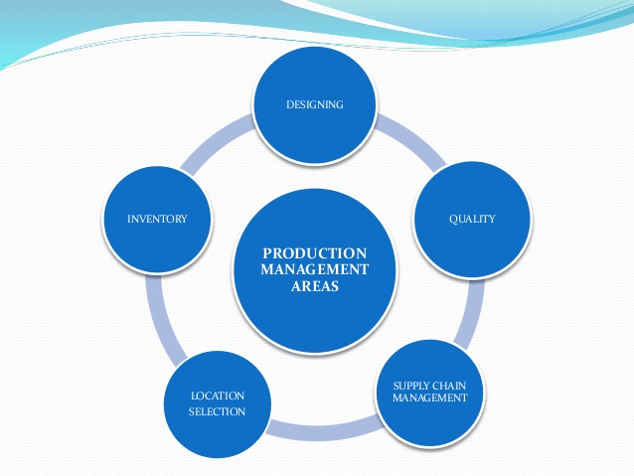
Production Management

Slide 5
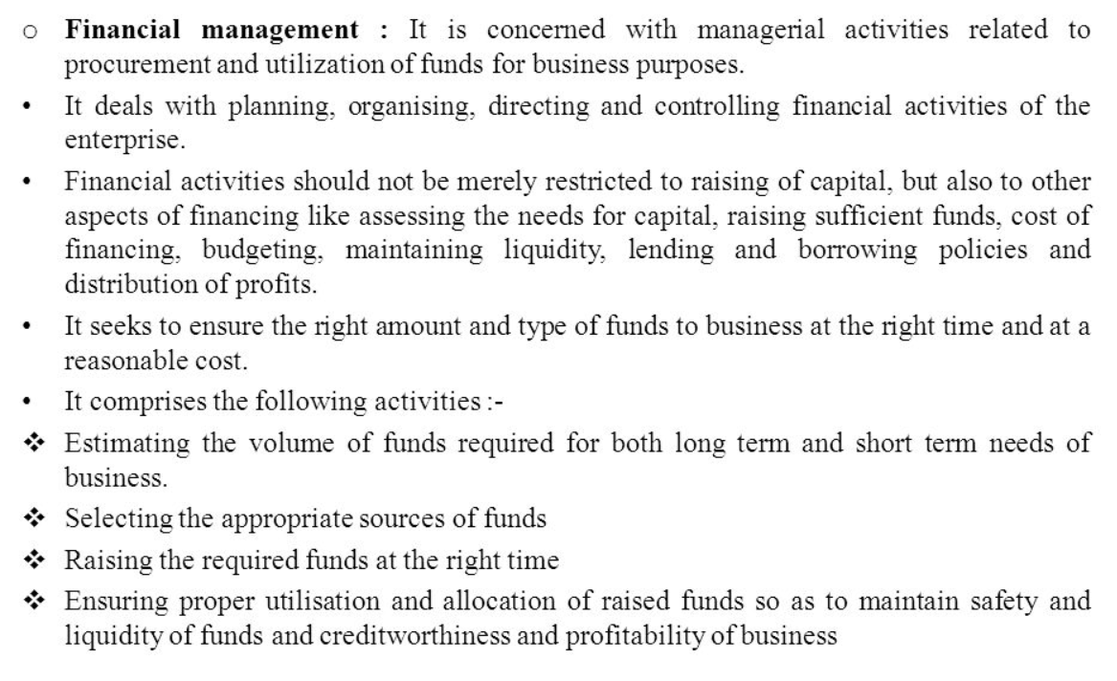
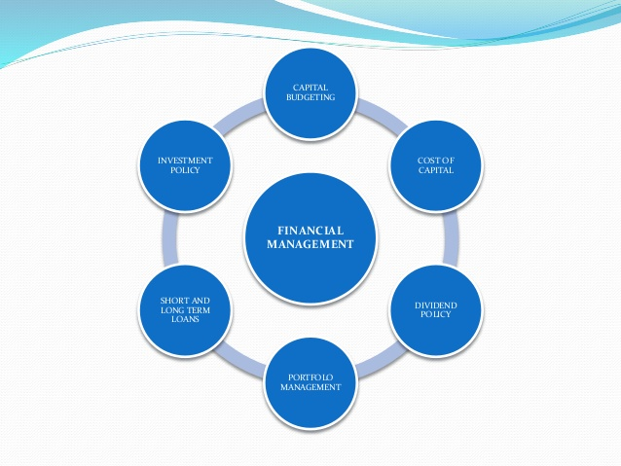
Financial management

Slide 6
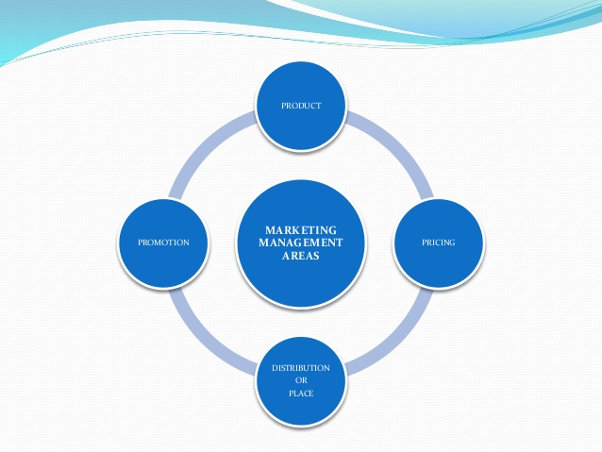
Marketing management
It refers to the identification of consumer’s needs and supplying them goods and services which can satisfy those wants.
Marketing research to determine the needs and expectations of consumers
Planning and developing suitable products
Setting appropriate prices
Selecting the right channels of distribution
Promotional activities like advertising and salesmanship to communicate with the customers

Slide 7
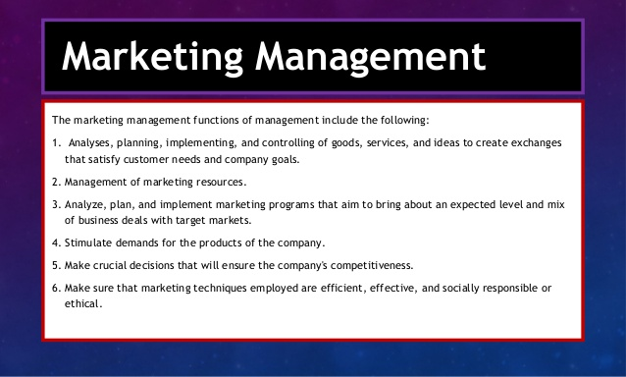

Slide 8
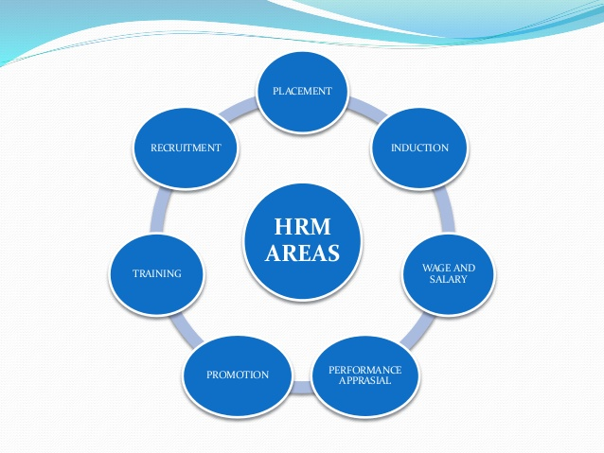
Personnel /HR management :
It is concerned with finding suitable employees, giving them training and fixing their remuneration and motivating them.
It is viewed as service function.
It basically deals with the management of human activities.
It involves planning, organising, directing and controlling the procurement, development, compensation, maintenance, etc. of the human resources in an enterprise.
It consists of the following activities :
Manpower planning
Recruitment
Selection
Training and development
Appraisal
Compensation and promotion
Employee services and benefits
Personnel records and research

Slide 9
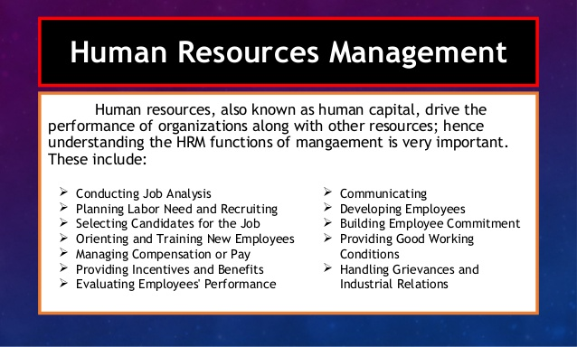

Slide 10
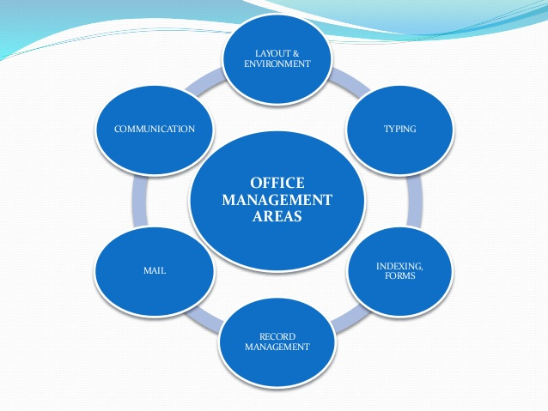
Office management
Office management is directing & controlling of an office in order to achieve its specified purpose in the most economical way. It is a process of overlooking the day- to-day operations of an office.

Slide 11
Coordination

Slide 12
Management involves coordinating and overseeing the work activities of others so that their activities are completed efficiently and effectively
Efficiency refers to getting the most output from the least amount of inputs. Because managers deal with scarce inputs—including resources such as people, money, and equipment—they’re concerned with the efficient use of those resources
Effectiveness is often described as “doing the right things”—that is, doing those work activities that will help the organization reach its goals

Slide 15
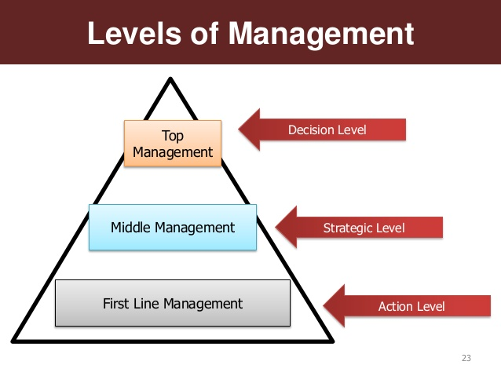

Slide 17
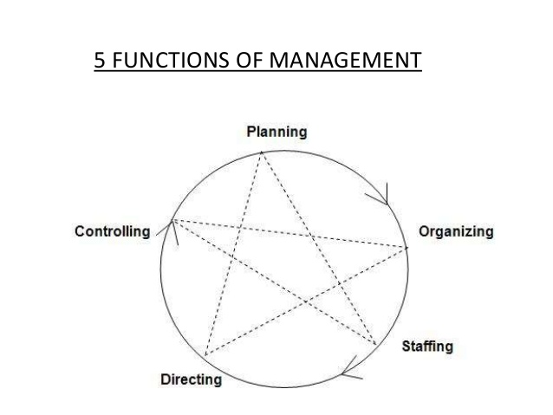
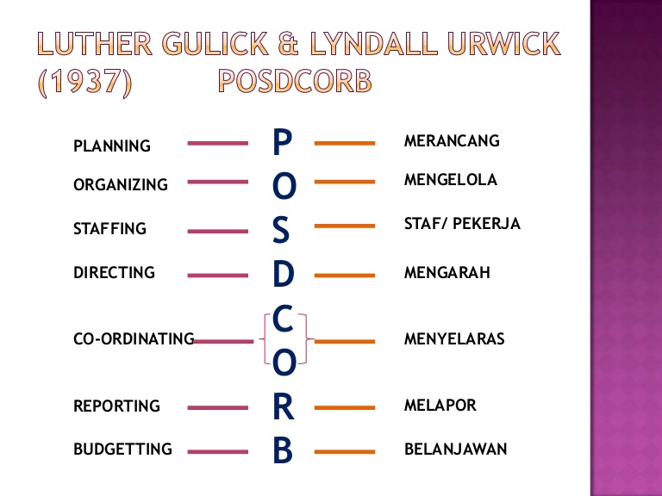

Slide 18
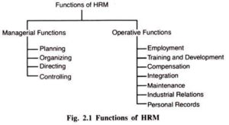

Slide 19
